Slide 1
Spring Boot

Slide 2
ville
Id:Long Name:String Longitude:double Latitude:double Altitude:double
Cinema
Id : Long Name : String Longitude:double Latitude:double Altitude:double nombreSalles:int
1 .. *
1 ..1
Place
Id:Long Numero:int Longitude:double Latitude:double Altitude:double
1..1
Salle
Id:Long Name:String nombrePlaces:int
1..1
1..*
1 ..*
1 .. *
ProjectionFilm
Id:Long dateProjection:Date Prix: double
1..1
1 .. *
Film
Id:Long titre:String Durre:double Realisateur:String Description:String Photo:String dateSortie:String
1..*
Ticket
Id:Long nomClient:String Prix:double codePayement:int Reservee:boolean
1..1
1..1
Categorie
Id:Long Name:String
1..1
Seance
Id:Long heureDebut:Date
1..*
1..*

Slide 3
REST web services : @RepositoryRestResource
connect to Spring Data repositories
basic CRUD functionality

Slide 4
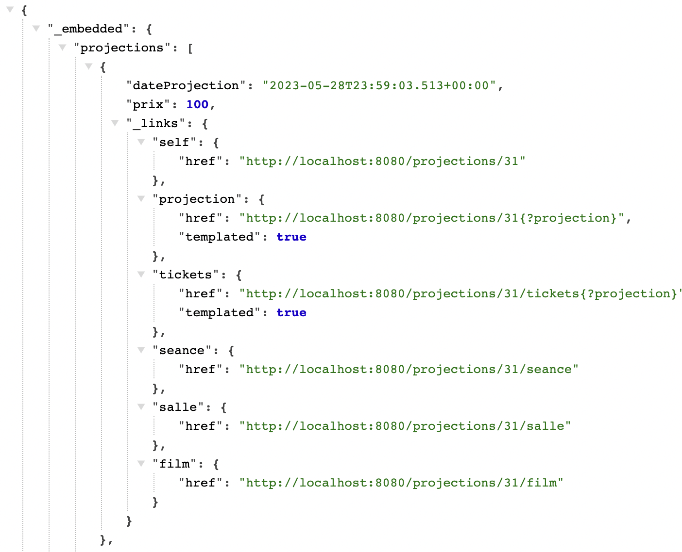
http://localhost:8080/salles/7/projection

Slide 5
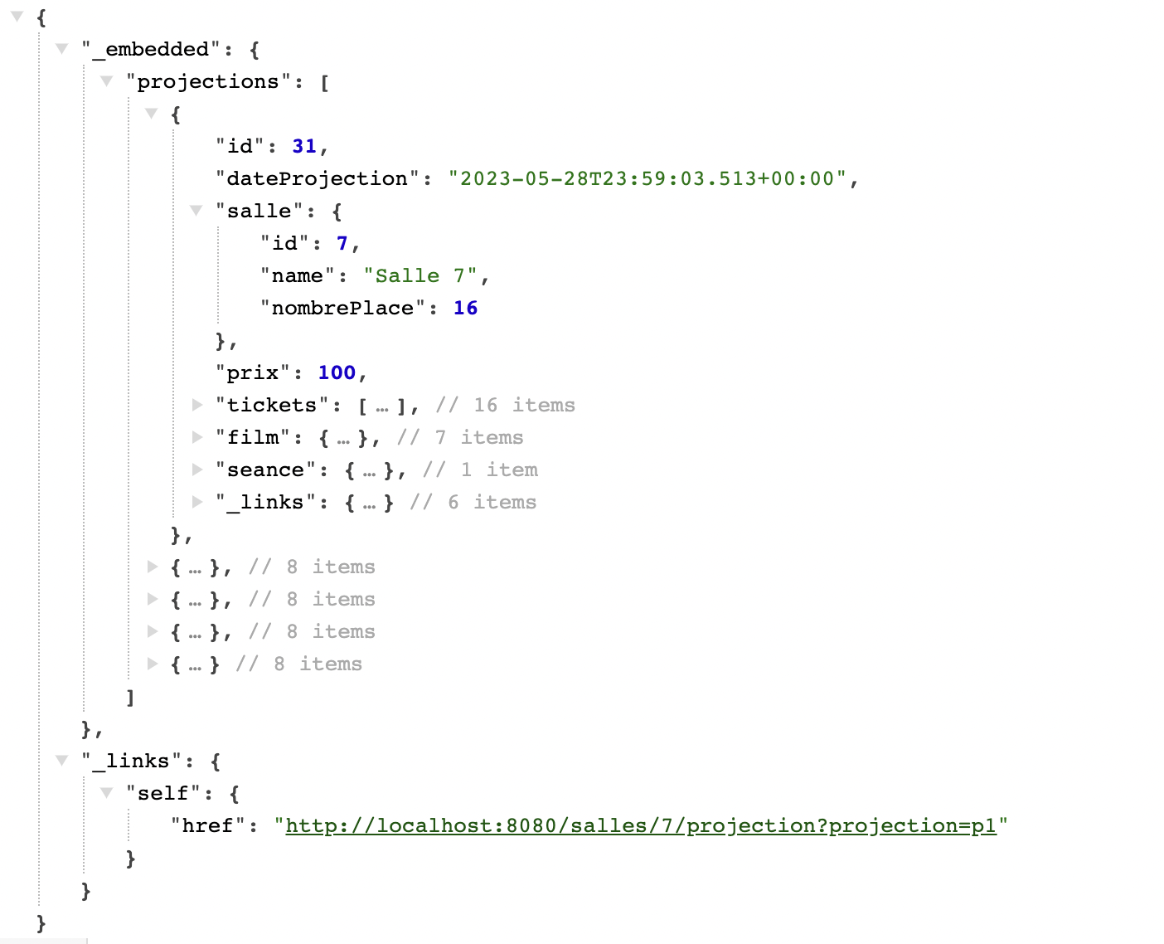
@Projection(name="p1",types={org.cinema.entities.Projection.class})
http://localhost:8080/salles/7/projection?projection=p1

Slide 6
Angular

Slide 7
app
CinemaService
cinema
ville
@output
ville
ville
Cinema-list
salle
<div class="card-body col-6" *ngFor="let item of salles._embedded.salles">
<app-salle [salle]="item" >
</app-salle>
</div>

